Slide 1
CoffeeScript is For Closers
Brandon Satrom
@BrandonSatrom
UserInExperience.com
Slides: bit.ly/pLWIMf

Slide 2

Put the Coffee(Script) Down! Coffee(Script) is for Closers!
Notes:
The title of this presentation is not a closure joke. It’s a reference to a quote from Alec Baldwin in the movie Glengarry Glenn Ross. And in spite of it’s kitschy nature, it does have a meaning in this presentation. But I’m getting a little bit ahead of myself. As this presentation has more faces than Eve, we should talk a bit about alternate titles…

Slide 3
Or…
JavaScript, Linguistics and Cockney Rhyming Slang
Notes:
I love Kurt Vonnegut, and if you’re familiar with his work, he loved to give his books alternate titles. For example, Slaughterhouse Five has the alternate title “The Children’s Crusade: A Duty-Dance with Death.” Breakfast of Champions has the alternate title “Goodbye Blue Monday.” In fact, Vonnegut had a tendency to choose catchy titles, while creating secondary titles that more aptly described the book. In that vein, this presentation is also titled “JavaScript, Linguistics and Cockney Rhyming Slang.
Not to be outdone by Mr. Vonnegut, I have yet another title for this presentation

Slide 4
Or…
How CoffeeScript Made me a Better JavaScript Developer
Notes:
More accurately of all, How CoffeeScript Made me a Better JavaScript Developer

Slide 5
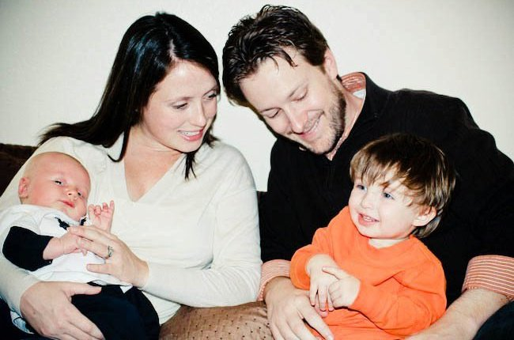
So Who Am I?
Husband and Father
Web Developer & Evangelist, Microsoft
Austin, TX
www.userinexperience.com
@BrandonSatrom
github.com/bsatrom
Notes:
So who am I, anyway?

Slide 6
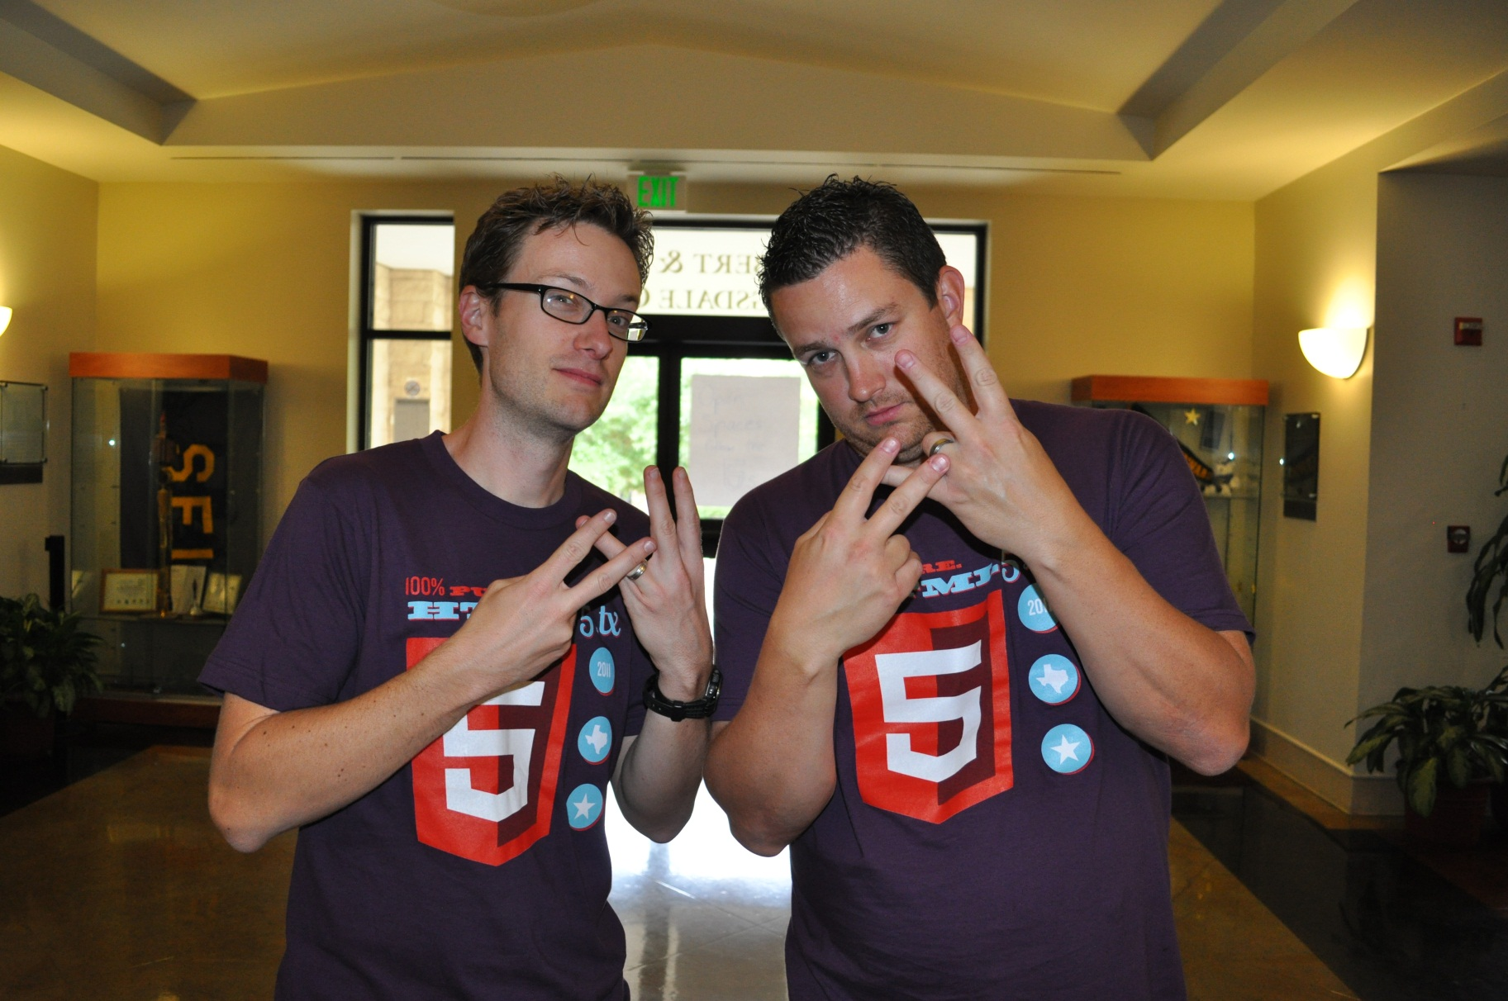
#html5tx
Notes:
I’m also one of the founder of HTML5.tx, an all-things open web conference in Austin, TX.

Slide 7
Agenda
The JavaScript Dialectic
What?
Where?
How?
Why?

Slide 8


VS.
Notes:
I expect that there are three types of people here today when it comes to JavaScript. You’re either:
A die hard CoffeeScript Fan
Skeptical of CoffeeScript
Don’t have enough information to decide yet
However, I think it’s fair to say that most of us tend to view CS and JS as an either-or decision. We must debate about them, and decide which is better, as we do with all things in life.

Slide 9

A JavaScript Dialectic
Notes:
There are lots of ways to conduct arguments or discussions
There is the “Beard Slap” extreme, where arguments are settled by force
Then there is settling arguments via rhetoric
Debates are a little bit better, but each side still comes to the table with the goal of winning.
Today, I would like to propose that we take a dialectical approach to CoffeeScript.
A Dialectic is a method for resolving disagreement, around in both Western and Eastern philosophy for thousands of years.
“Dialogue between two or more people holding different points of view about a subject, who wish to establish truth of the matter by dialogue, with reasoned arguments.”
- This is different than debate, where each party is committed to their points of view and mean to win the debate.
- Also different than rhetoric, which appeals to emotion rather than logic and reason.

Slide 10


Don’t Be A JavaScriptster
I loved JavaScript before it was cool
Of course, I also hated it back when everyone else did too…
Notes:
If you are skeptical, though, I only ask that you not be a JavaScripster. Be willing to consider the place that CoffeeScript might have in your own development, and do try it for yourself.
The point of a dialectic, at least as I understand it, is to bring people with opinions together. As long as the people are more interested in knowledge and progress than “winning the argument,” there is potential for everyone to learn and to grow in their thinking. I may represent one viewpoint, but I am open to having my own mind changed by you all. I hope, in the course of this conversation, that we can all leave with different perspectives on CoffeeScript, but also JavaScript in general.

Slide 11

Don’t Be A CoffeeScriptster
JavaScript is lame! Significant Whitespace FTW!
Let’s hope they don’t notice that I still debug in JavaScript…
Notes:
Let’s be careful, though. Because dialects have their place. They grow up with their own cultural and geo-political influences, so dismiss them outright as somehow inferior to what we prefer is to ignore the history of that language, and the noble growth of programming as a profession.
Putting it another way, if you’re using CoffeeScript because you think JavaScript sucks, you’re doing it wrong.

Slide 12
What?
What is CoffeeScript?
Notes:
Let’s start by talking about what CoffeeScript is. Now I’m assuming that, since this is a JS conference, most of you already know, and you probably know a bit about the language itself. So I’m not going to linger here, because I think the dialectic part of this presentation is of larger importance.

Slide 13
“It’s Just JavaScript”
Or “Unfancy JavaScript”
Notes:
The first rule of CoffeeScript, according to its website, is “It’s just JavaScript”

Slide 14
“A polyglot language”
A Ruby, Haskell and Perl love child…
Notes:
I would also style CoffeeScript as a polyglot language, because it draws inspiration fro Ruby, Perl and other languages. All programming languages draw their inspirations from somewhere, of course, but CofeeScript seems to be a part of a wave of languages being created as “polyglot programming” becomes more mainstream, and programmers look for new ideas and inspirations.

Slide 15
“A little language”
Meaning…it’s not DART
Notes:
It’s also a little language. CoffeeScript is different than these “big, existing language compiling to JS” frameworks in that it’s not designed to let you write JavaScript in some other existing language or framework. Many of those let you use framework libraries, and thus have to replicate them to JS, which is why “Hello World” in DART is 17,209 lines of code.
CoffeeScript is a NEW language, inspired by others. And believe it or not, it wasn’t created as a way to help you avoid JavaScript all together.

Slide 16
Transpiler vs. Compiler
Transpiled Languages
Compiled Languages
CoffeeScript
Traceur
EcmaScript 5 Parser
Reflect.js
DART
GWT
Objective-J
ClojureScript
JSIL
Script#
Emscripten
Haxe
LIAR!
Notes:
A transpiler performs syntax-only (or mostly) translation from a source language to a destination language. New semantics or language concepts aren’t introduced. On the other side of things fully-compiled languages introduce new semantics and language concepts,
Ok, I’ll be honest, I’m kind of lying a bit on this concept. By definition, the real definition of a transpiler is a language compiler that complies from one source language into another. By that definition, all of these languages are transpiled.
HOWEVER, after his JSConf talk with Jeremy Ashkenas, Brendan Eich wrote a blog post about JS.NEXT, CoffeeScript and Google Traceur where he made the distinction between languages like Traceur and CoffeeScript, and languages like Dart, GWT and Objective-J.
From http://brendaneich.com/tag/transpiler/:
But more on that later…

Slide 17
More A Dialect, Less A Language
Color === Colour
function(foo) {} === (foo) ->
Notes:
Let’s put it in less controversial terms. It’s helpful to think of CoffeeScript more like a dialect of JavaScript, and less like an entirely new, foreign language.

Slide 18
Subtle Linguistics
Dave has two children. His youngest is in Reception, and his favourite colour is green. His oldest is Year 4, and loves to ride the lift outside his flat.
Dave has two children. His youngest is in Pre-K, and his favorite color is green. His oldest is in 3rd Grade, and he loves to ride the elevator outside his apartment.
Notes:
Think of CoffeeScript and JavaScript like the Queens English and American English. They are syntactically equivalent, with only slight variations on spelling and popular word choice. As a native english speaker, I can read and understand both, and can either deduce or look up what I don’t. My mind transcompiles the Queen’s english in print or spoken form to the native semantics I understand.
Neither linguistic choice is more right or wrong than the other, because the choice is mostly dictated by cultural and local factors.
[Awesome to have an animation effect here that highlights words in each paragraph, then fades out the american text, replaces it with british and pulls back in american text]

Slide 19
Not so subtle linguistics…
Sentence | Extended Phrase | Rhymes With
I’ve got a sore billy. | Billy Goat | Throat
That’s a nasty old boris you’ve got there son. | Boris Karloff | Cough
Ere, you’ve got your brass wrong! | Brass Tacks | Facts
‘ow about a Brittney? | Brittney Spears | Beers
We’re all in Barney! | Barney Rubble | Trouble
Think he’s been smoking a bit of Bob | Bob Hope | (you get the idea)
Notes:
Of course, some might argue that the difference between CoffeeScript and JavaScript is more like American English and Cockney Rhyming slang, than American and The Queens English. In this case, the differences between the language require an intermediate processing step, whereby a key phrase must be expanded upon, then mapped to the best rhyming equivalent that makes sense in the context of the sentence.
I would argue, this is more like DART, but it does make an important point, both about learning a language and about CoffeeScript vs. JavaScript.
If you’re coming to English as a non-native speaker, the subtle to major differences between American English, the Queens English and Cockney Rhyming Slang can prove to be major pitfalls to being productive with capital E English. They will slow you down. This brings me to my first categorical imperative about CoffeeScript.

Slide 20
CoffeeScript is not a replacement for Learning JavaScript
CoffeeScript Axiom #1
Notes:
In traditional logic, an axiom or postulate is a proposition that is not proven or demonstrated but considered either to be self-evident or to define and delimit the realm of analysis. In other words, an axiom is a logical statement that is assumed to be true. Therefore, its truth is taken for granted, and serves as a starting point for deducing and inferring other (theory dependent) truths.

Slide 21
Compiles 1:1 to JavaScript
1:1 being Concept to Concept
Notes:
Let’s get back to CoffeeScript itself. The biggest reason why I’m claiming that CoffeeScript is a dialect of JavaScript is because is compiles 1:1 to JavaScript. This doesn’t mean 1 line to 1 line, but 1 concept to 1 concept.

Slide 22
Conceptual Equivalence
CoffeeScript
JavaScript
numbers = [1..10]
printNum = (number) ->
console.log "This is number #{number}"
printNum for num in numbers
var num, numbers, printNum, _i, _len;
numbers = [1, 2, 3, 4, 5, 6, 7, 8, 9, 10];
printNum = function(number) {
return console.log("This is number " + number);
};
for (_i = 0, _len = numbers.length; _i < _len; _i++) {
num = numbers[_i];
printNum;
}
Notes:
Let’s take a look at what that means
This first line shows both variable declaration and assignment, as well as an array declaration. The right-hand side shows the exact JavaScript that CoffeeScript generates.

Slide 23
Conceptual Equivalence
CoffeeScript
JavaScript
numbers = [1..10]
printNum = (number) ->
console.log "This is number #{number}"
printNum num for num in numbers
var num, numbers, printNum, _i, _len;
numbers = [1, 2, 3, 4, 5, 6, 7, 8, 9, 10];
printNum = function(number) {
return console.log("This is number " + number);
};
for (_i = 0, _len = numbers.length; _i < _len; _i++) {
num = numbers[_i];
printNum(num);
}
Notes:
The second example shows a function definition. This tends to be the biggest shift for people because of the syntax, and because a function block is whitespace significant. It is a matter of taste, but again, conceptually equivalent to the final JS.

Slide 24
Conceptual Equivalence
CoffeeScript
JavaScript
numbers = [1..10]
printNum = (number) ->
console.log "This is number #{number}"
printNum num for num in numbers
var num, numbers, printNum, _i, _len;
numbers = [1, 2, 3, 4, 5, 6, 7, 8, 9, 10];
printNum = function(number) {
return console.log("This is number " + number);
};
for (_i = 0, _len = numbers.length; _i < _len; _i++) {
num = numbers[_i];
printNum(num);
}
Notes:
The third example shows string interpolation. Again, the resulting JavaScript is conceptually the same

Slide 25
Conceptual Equivalence
CoffeeScript
JavaScript
numbers = [1..10]
printNum = (number) ->
console.log "This is number #{number}"
printNum num for num in numbers
var num, numbers, printNum, _i, _len;
numbers = [1, 2, 3, 4, 5, 6, 7, 8, 9, 10];
printNum = function(number) {
return console.log("This is number " + number);
};
for (_i = 0, _len = numbers.length; _i < _len; _i++) {
num = numbers[_i];
printNum(num);
}
Notes:
Finally, a loop. Though the CoffeeScript is much more terse, the resulting JS makes sense.

Slide 26
Where?
Where do I get it?
Notes:
Let’s talk briefly about where to get CoffeeScript

Slide 27
Ways to Get CoffeeScript
node.js & npm
Script Tags
<script type=“text/coffeescript”></script>
<script src=“coffee-script.js”></script>
Rails 3.1
SassAndCoffee (.NET)
CoffeeScript Packages
$ npm install –g coffee-script
Notes:
The most often mentioned way of getting CS is via Node and NPM, which hopefully you are all using by now.
There is also a way to use text/coffeescript tags on a page with embedded CS blocks, then reference the CS compiler to compile those on the fly, but that’s not recommended for serious use. I wouldn’t use this at all.
Rails 3.1 includes CS by default
For .NET, you can download SassAndCoffee, which provides support for CoffeeScript and Sass inside of Visual Studio.
Beryond that, every language with a package management system has a CoffeeScript package that you can quickly grab from the command-line.

Slide 28

Tools for CoffeeScript
IDE Extensions/Plugins
Asset Pipeline Tools
Live Debugging/Preview
See more at http://bit.ly/nx6JGo
Notes:
Bottom line, you have options, even if they are controversionl. Talk about Rails Controversy with Rails 3.1, and how the community freaked out with the inclusion of CoffeeScript by default. So even the use of CoffeeScript tooling has a religious or political tinge to it.
Tools for CoffeeScript fall into two major categories, Text Editor extensions, and web framework plugins. There are CoffeeScript extensions, bundles and plugins for just about every IDE imaginable: TextMate, Vim, Eclipse, NetBeans, VisualStudio, Sublime Text, and more.
For WebFramework Plugins, there are several available for PHP, Python, Ruby, .NET and Java. Some, like PHP, Python and Rails, add CoffeeScript to their existing Asset management tools. For example, CofeeCup is a WSGI middleware wrapper that compiles CoffeeScript to JavaScript on demand.
For a full list of Text editor plugins, see: https://github.com/jashkenas/coffee-script/wiki/Text-editor-plugins. For Web Framework Plugins, see: https://github.com/jashkenas/coffee-script/wiki/Web-framework-plugins
Image from the hilarious discussion that ensued after CoffeeScript was included in the default Gemfile for Rails 3.1 - https://github.com/rails/rails/commit/9f09aeb8273177fc2d09ebdafcc76ee8eb56fe33

Slide 29
How?
How can I use, learn and automate it?
Notes:
Once you get CS, how do you use it?

Slide 30
REPL
$ coffee
coffee> [1..10]
Notes:
The easiest way to get started learning CoffeeScript after you’ve installed it via NPM is using the REPL available via the coffee command.
[DEMO] Show REPL with some basic commands

Slide 31
COMPILE
$ coffee –o js/ -cw lib/
Notes:
As useful as the REPL is, eventually, you’re going to want to compile COFFEE files into CoffeeScript.
This is the simplest way to build CoffeeScript, from the command-line. There are countless other ways, and you can check out https://github.com/jashkenas/coffee-script/wiki/Build-tools for more information on CoffeeScript build tools. The point is that, even though, CoffeeScript is a compile step, there are tons of ways to set up automated compilation and monitoring yourself so that that step isn’t manual.
[DEMO] Show using the –c command, then the –w command in a new directory

Slide 32
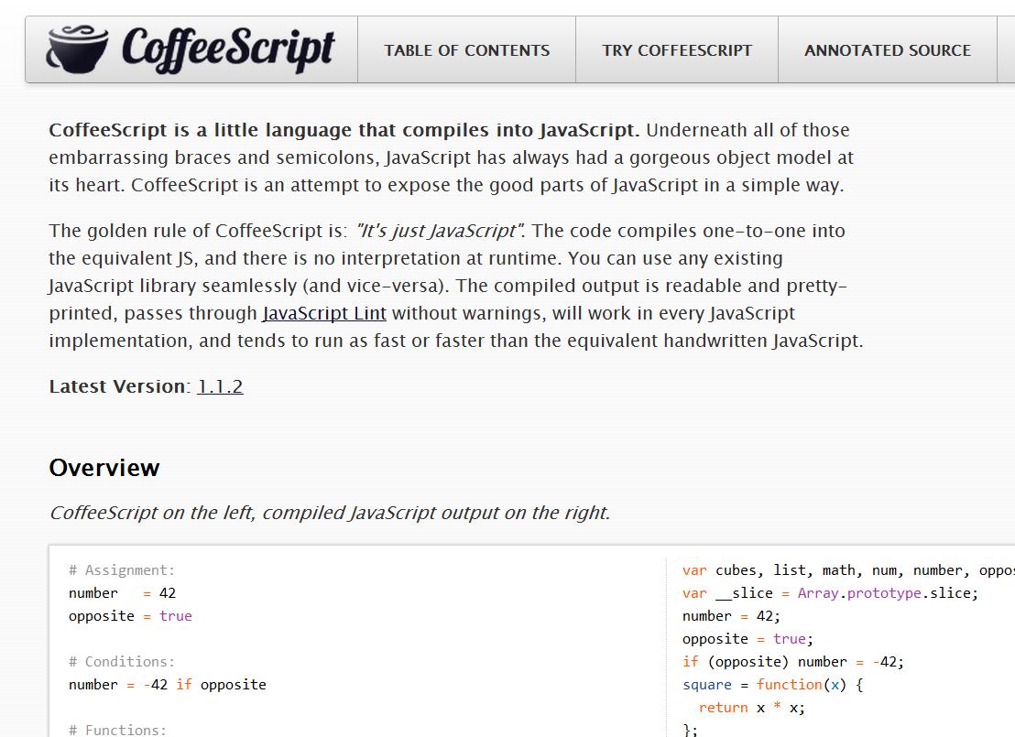
CoffeeScript Basics
Notes:
Let’s take a quick look at some CoffeeScript basics, for those who haven’t seen it before. As I said already, I’m not going to spend a ton of time here because you won’t remember it all, and this presentation is much more about the why than the how.
[DEMO] Go to the CoffeeScript Home page, sow the overview, as well as the try coffeescript pane and the “Load” link in each sample

Slide 33
Assignment
name = “Brandon”
married = yes
children = 2
var children, married, name;
name = "Brandon";
married = true;
children = 2;

Slide 34
Functions
square = (x) -> x * x
printInfo = (name, numChildren) ->
“Hi #{name}, I see you have #{numChildren} children.”
var printInfo, square;
square = function(x) {
return x * x;
};
printInfo = function(name, numChildren) {
return "Hi " + name + ", I see you have " + numChildren + " children";
};

Slide 35
Strings
num = 99
“I’ve got #{num} problems, and JavaScript ain’t one.”
city = "Brooklyn"
"No. Sleep. 'Till. #{city}"
var city, num;
num = 99;
"I've got " + num + " problems, but JavaScript ain't one";
city = "Brooklyn";
"No. Sleep. 'Till. " + city;

Slide 36
Objects
kids =
bigBrother:
name: “Benjamin”
age: 2
littleBrother:
name: “Jack”
age: 1
var kids;
kids = {
bigBrother: {
name: “Benjamin”,
age: 2
},
littleBrother: {
name: “Jack”,
age: 1
}
};

Slide 37
Lexical Scoping
outer = 42
findMeaning = ->
inner = 43
outer
inner = findMeaning()
var findMeaning, inner, outer;
outer = 42;
findMeaning = function() {
var inner;
inner = 43;
return outer;
};
inner = findMeaning();

Slide 38
Lexical Scoping 2
notGlobal = "Hello"
global = "Goodbye"
window.global = global
(function() {
var global, notGlobal;
notGlobal = "Hello";
global = "Goodbye";
window.global = global;
}).call(this);

Slide 39
Everything, an Expression
grade = (student) ->
if student.excellentWork
"A+"
else if student.okayStuff
if student.triedHard then "B" else "B-"
else
"C"
eldest = if 24 > 21 then "Liz" else "Ike"
var eldest, grade;
grade = function(student) {
if (student.excellentWork) {
return "A+";
} else if (student.okayStuff) {
if (student.triedHard) {
return "B";
} else {
return "B-";
}
} else {
return "C";
}
};
eldest = 24 > 21 ? "Liz" : "Ike";
Notes:
Compiler tries to make sure that all statements can be used as expressions, so the last statement of all blocks is returned.

Slide 40
Conditionals
mood = greatlyImproved if singing
if happy and knowsIt
clapsHands()
chaChaCha()
else
showIt()
lunch = if friday then water else redBull
options or= defaults
var lunch, mood;
if (singing) {
mood = greatlyImproved;
}
if (happy && knowsIt) {
clapsHands();
chaChaCha();
} else {
showIt();
}
lunch = friday ? water : redBull;
Options || (options = defaults);

Slide 41
Operators and Aliases
CoffeeScript | JavaScript
is, == | ===
isnt, != | !==
not | !
and | &&
or | ||
true, yes, on | true
false, no, off | false
@, this | this
of | in
in | no equivalent
Notes:
CoffeeScript ALWAYS compiled == into === and != into !==
“in” in CoffeeScript is used for loop comprehension and testing for array presence, not for testing object-key presence. To do that in CoffeeScript, use “of.” That’s an oddity that I don’t like.

Slide 42
How I Use CoffeeScript
Let’s pretend for a moment that how I use it, matters.
Notes:
One of the things I want to be sure to mention is that the compile step in CoffeeScript doesn’t have to be a laborious manual step that takes you a lot of time. What’s more, with Node in the mix, and a testing tool like qUnit or Jasmine, you can perform automated testing on the JavaScript generated by CoffeeScript, reducing the amt of time debugging that code.

Slide 43
Coffee, Cake and Growl
Cake (think Make or Rake)
‘watch’ Task
wingrr (use node-growl for *nix)
invoke 'build'
invoke 'tests'
msg = 'All test pass'
sys.puts msg.green
wingrr.notify msg
Notes:
Describe my process for using CoffeeScript with Cake and Wingrr, my Windows Node Growl plugin (https://github.com/bsatrom/wingrr). Talk about how I do this because I can use Qunit or Jasmine to aid with Automated testing. This is not the ONLY way, or even the best way, just my way of doing things.
[DEMO] Show Cake, Coffee, Tests and Wingrr. Make a change and show it running

Slide 44
Why?
Why should I bother using it?
Notes:
Now that we’ve gotten the “what is it?” and how does one learn it/use it, out of the way, let’s spend a moment talking about the why of coffeescript. As I said earlier, I’m not going to take for granted that you even want to learn coffeescript, and I’ve spoken to several people who claim to be “not sold yet.” So I want to spend a significant amount of time talking about why I think CoffeeScript is important, and less of a syntax overview.

Slide 45
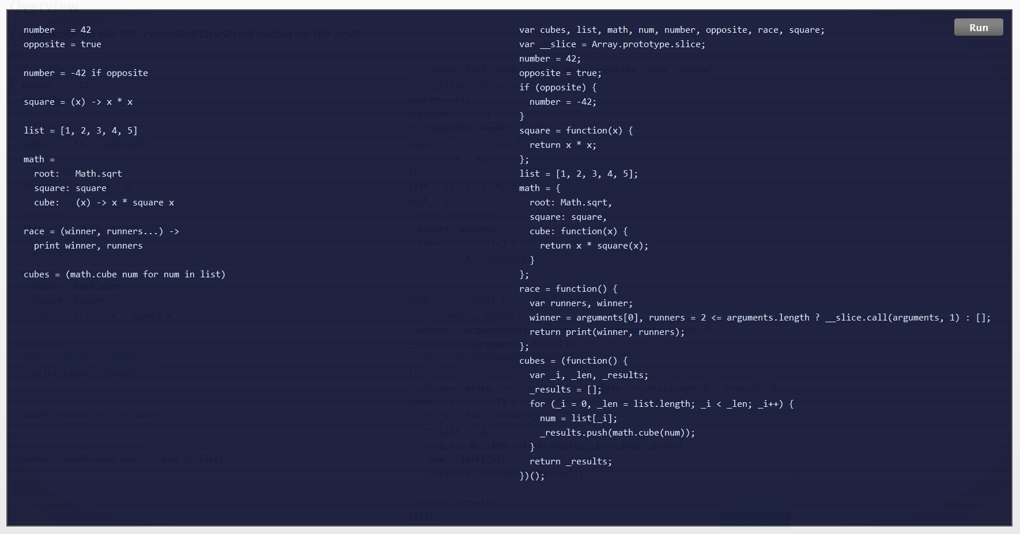
Pro
More succinct code
Notes:
CoffeeScript does tend to be more terse, mainly because of the lack of braces and use of whitespace.

Slide 46
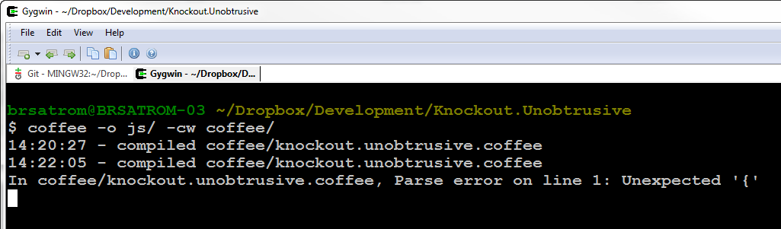
Con
Extra compile step between you and the “real” code
Notes:
There’s an extra compile step between the code you write in CoffeeScript and the code your site eventually executes, which is still JavaScript.

Slide 47
Pro
hi == bye
global = "everywhere?"
switch day
when "Fri", "Sat"
if day is bingoDay
go bingo
go dancing
when "Sun" then go church
else go work
(function() {
var global;
hi === bye;
global = "everywhere?";
switch (day) {
case "Fri":
case "Sat":
if (day === bingoDay) {
go(bingo);
go(dancing);
}
break;
case "Sun":
go(church);
break;
default:
go(work);
}
})();
Avoid Snake Pits & Get JS Patterns for Free
Notes:
Avoids the "snake pits" of JavaScript
coercive equality, with(), fall-through-switch statements
Js Design patterns are features of JS
Lexical scoping - no global variables

Slide 48
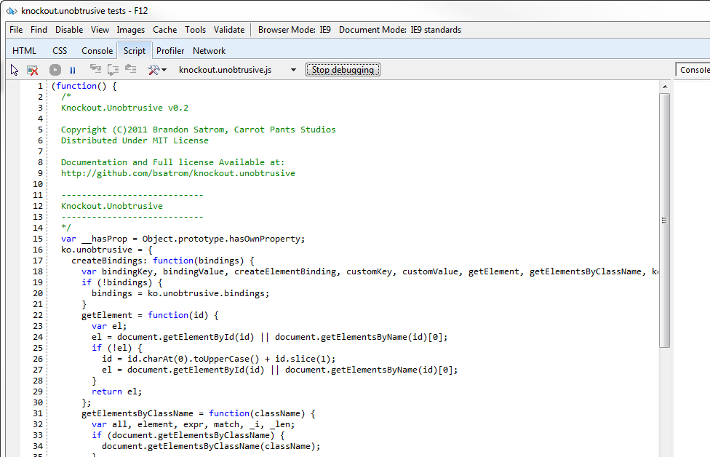
Con
Errors and Debugging: it’s still JavaScript in there
Notes:
But when it comes time to debug issues in your CoffeeScript, you do still have to debug in JS.

Slide 49
Pro
Conjecture!
As fast or faster JavaScript
Notes:
There’s a claim on the site that the CoffeeScript you write will output JavaScript that’s as fast or faster than the JS you write today. This is obviously anecdotal, and based largely on the assumption that you use for each instead of raw for loops, which are faster.

Slide 50
Con
Code Generation(?)!
Dare I say it? Code Generation!
Notes:
CoffeeScript does generate JavaScript code that you have to live with. That was my first sticking point at the beginning.

Slide 51

Ok, CoffeeScript is Opinionated
Shirts are for n00bs…
Like all software is…
Notes:
All of the arguments about avoiding snake pits and getting patterns for free rests on the assumption that you agree with the way those patterns are implemented.
CoffeeScript is also heavily inspired by the idea of literate programming, where you write source code as prose, an essay for another person to read, as opposed to a series of instructions for a machine to execute. One of the reasons it appeals to me is that it creates a source that a human can read, plus a source that respects the maching, while also making sure that the generated source is still human readable and de-buggable, as much as possible.
Some people balk at claims that CoffeeScript uses JS patterns by default, or that it generates human-readable JS. The response is typically, “well, those aren’t my patterns” or “that’s not the code I would write.”

Slide 52

With Apologies to the Ninjas
Notes:
Image from http://www.quickmeme.com/meme/357akl/
And for those of you who are JavaScript ninjas, maybe that’s both true, and a valid reason to avoid the language entirely. But let me tell you about my experience with CoffeeScript, as someone who is not a JavaScript ninja, but rather a career web developer who has used JavaScript for 12 years, but realizes that he missed a beautiful language for most of that time.

Slide 53
The Five Stages of JavaScript
Avoidance
Concession
Abstraction
Failure
Enlightenment
Notes:
I would refer to my own journey with JS as the Five Stages of JavaScript.
Now I’m not a doctor, so I can’t generalize these experiences to everyone, but they did hold true for me.
Avoidance - 1996
Lazy JavaScript
Browser Sniffing
Concession - 2003
Semi-Lazy JavaScript
Ajax
Abstraction - 2006
jQuery FTW!
jQueryScript
Failure - 2009
Hey, JavaScript is pretty nice!
HTML5
Trying to write my own jQuery Plugin
And JavaScript libraried by hand
Enlightenment - 2011
HTML5
JavaScript books like Eloquent JavaScript, JavaScript the good parts
CoffeeScript has only continued that trend.

Slide 54
arr = new Array(4, 8, 15, 16);
arr[4] = 23;
arr[5] = 42;
for (i = 0; i < arr.length; i++)
{
enterLottoNum(arr[i]);
}
Notes:
Let’s talk a little bit more about stage 5, and what role CoffeeScript has played in my growth as a JavaScript programmer.
Here’s an example of some JavaScript I might have written 10 years ago, when being a web developer was more about back-end frameworks than the client. I’m sure you can see, as I do now, a few of the horrible mistakes I made with this code.

Slide 55
var arr = [4, 8, 15, 16, 23, 42];
for (var i = 0; i < arr.length; i++) {
enterLottoNum(arr[i]);
}
Notes:
Here’s an example of some JavaScript I might have written a few years ago. Much better, because I actually understood the language.
While this is worlds better than the JS I originally wrote, there are still a few minor best-practices I discovered I am violating, but I didn’t catch until I started using CoffeeScript.

Slide 56
var arr, num, _i, _len;
arr = [4, 8, 15, 16, 23, 42];
for (_i = 0, _len = arr.length;
_i < _len; _i++) {
num = arr[_i];
enterLottoNum(num);
}
Notes:
This, is what I learned to write after reading the output generated by CoffeeScript. The differences are subtle, but I’m guessing that some of you see them. Two differences, in fact. For one, I’m declaring my iterator variable at the top of the scope, as I should. Then, I’m assigning the length of my array to a variable, so that I only access the unchanging length property once, as opposed to every time through.
These are subtle differences, I know. And I also know that some of you probably learned to use them without the help of CoffeeScript. For that, I applaud you. [Next Slide]

Slide 57
CoffeeScript made me want to be
a better man
JavaScript
Programmer
Notes:
But for me, I’m a very kinetic learner. Working through exercises in a book is useful, but I learn best when I’m using a living with a debugging a thing. Working with CoffeeScript was, for me, like having my ideas about a web program expressed by another developer. Not a better or poorer developer, because I didn’t always agree with those opinions. But in areas where I hadn’t yet internalized a pattern or good practice, CoffeeScript generated JS that I was able to learn from and internalize.
I’m still in the fifth stage, if only barely, but if there’s anything that’s true it’s that there is no sixth stage. There is nothing beyond JS, and embracing CS wasn’t about that, but about becoming a better JS priogrammer.
Learning CS helped me better learn JS. Reading and debugging my CS made me a better JS developer, because I learned about the patterns and conventions it conveyed. And it did all of this without creating a lot of JS that I couldn’t read and debug myself.

Slide 58
CoffeeScript can help you become a better JavaScript programmer
CoffeeScript Axiom #2
Notes:
So that brings me to Axiom #2. Books and online resources are great, but I would argue that using CoffeeScript is another way to become a better JavaScript developer. I am actually spinning that it generates JS for you as a good thing. I personally learned a lot in the process.
And this, for me, is only true because you still have to debug the JavaScript that CoffeeScript creates.

Slide 59
But there’s nothing wrong with JavaScript!
Notes:
Ok, in spite of my experience with CS and how it helped me write better JS, you might still be skeptical. Perhaps you would argue that we don’t need a language like CS because there’s nothing wrong with JS to begin with.

Slide 60

Notes:
Let’s not pretend that JavaScript doesn’t have it’s warts. That’s a JavaScriptster attitude to pretend that the language is perfect. No programming language ever invented is perfect.
If JavaScript were fine as is, there would be no EcmaScript5 and no TC39 committee discussing Harmony or JS.Next.
Right now, we are battling against two forces, those two wish to replace JS, and those to wish to evolve it.

Slide 61
Influencing JS.Next
let name = “block scoped!"
const REALLY = "srsly"
#add(a, b) { a + b }
module Mod {
export const K = “foo”
export #add(x, y) { x + y }
}
Function
Declaration!
Notes:
Brendan Eich has said that JS.Next is being influenced by CoffeeScript, and Jeremy himself has claimed that as a goal for the language.
The truth it, JavaScript is evolving. It’s not the unchanging language of the last decade. We can insist that it’s fine as is, but it’s going to change anyway. Hopefully you’re aware of some of those proposed changes. And using a languages like CoffeeScript help you evolve you thinking of JavaScript and open your mind to what’s possible in the future.
The code example above is taken from the “Harmony of My Dreams” blog post by Brendan Eich (http://brendaneich.com/2011/01/harmony-of-my-dreams/)
[Show examples of some of the crazy CoffeeScript like stuff Brendan is thinking about for JS.Next]

Slide 62
Whither JavaScript?
“The only thing that happens when new languages pop up is that JavaScript gets better.”
– Chris Williams
Notes:
http://blip.tv/jsconfeu/chris-williams-an-end-to-negativity-5635852
The bottom line is that JavaScript is not static, it is evolving and changing
Don't hate language evolution. CoffeeScript is helping people love and appreciate JavaScript. And its helping the language get better. Don't hate on that progress

Slide 63
JavaScript Gets Better
JavaScript
jQuery, et al.
ECMAScript 5
CoffeeScript
Harmony/JS.Next
?
Notes:
A JavaScript Timeline
Point is that CoffeeScript isn't a destination, any more than JavaScript is. It's a step on the process. It makes the language better, and we get better as a result…
Jquery and Frameworks made JavaScript and working with the DOM better, and it influenced how we use the language (querySelector() is proof of that)

Slide 64
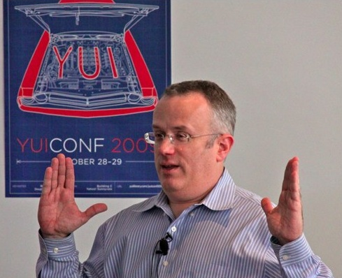
It’s not a replacement for JavaScript
"We are not just advocating a language on top of JS that you use to avoid JS (GWT, Haxe, Objective-J, etc.). We are advocating that you all help build a better JS on JS, which then becomes standardized as JS.next."
- Brendan Eich
CoffeeScript Axiom #3
Notes:
According to Brendan Eich, this is about bringing JavaScript full circle, not about replacing, but enhancing JavaScript. We shouldn’t see CoffeeScript as a threat to JavaScript because it wasn’t born in the same spirit as languages like GWT and Dart, where staying as far away from JS is the goal.
"We are not just advocating a language on top of JS that you use to avoid JS (GWT, Haxe, Objective-J, etc.). We are advocating that you all help build a better JS on JS, which then becomes standardized as JS.next." - Brendan Eich (re: his talk with Jeremy at JSConf.EU)

Slide 65
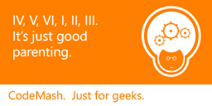
CoffeeScript is a JavaScript Polyfill
CoffeeScript Axiom #4, Special CodeMash Edition!
Notes:
Axiom #4 is an extension of number three, but I wanted to add it to make the point differently, and also because I gave this talk at RedDirt.js, and I wanted to do something special for you wonderful CodeMashers.
There’s been a lot of back and forth and hot air about CoffeeScript vs. JavaScript over the last couple of months, natural as CoffeeScript becomes more popular. But the biggest problem I have with these arguments is that they assume one *must* live in isolation of the other. That there can only be one, which is silly. I use both, neither to the exclusion of the other. And let’s face it, JavaScript can’t evolve as a language as fast as we want it to. CoffeeScript is a great solution for that, and it allows you to try out features (destructuring assignment and classes) that are being targeted for inclusion in EcmaScript/JS in the future today. Why would you not play with those features and see how great it would be to have them in your JS? It makes sense to use CS as a polyfill.

Slide 66
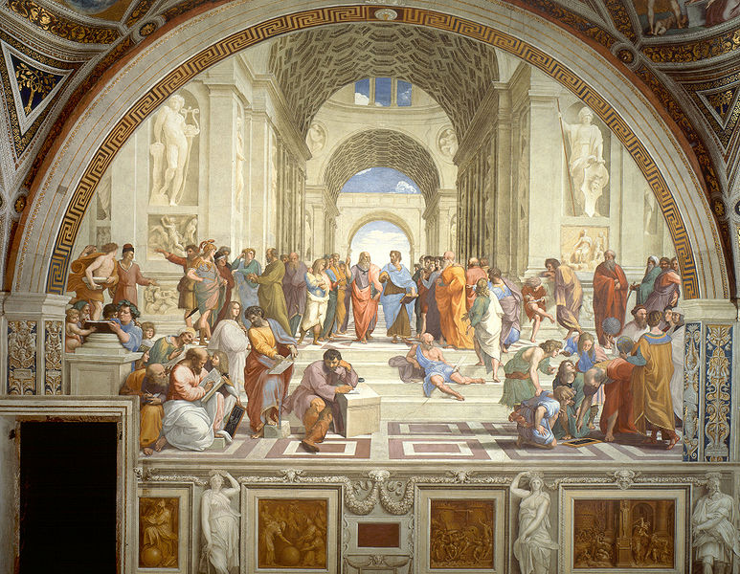
the JavaScript Dialectic, Revisited
What Can I/We/Everyone Learn from CoffeeScript?
Notes:
SO… In the spirit of the dialectic, here’s my proposal: “JavaScript is a beautiful language, but it has its snares and pitfalls. What’s more, it is constrained severely by backwards compatibility and committee-driven design. CoffeeScript IS JavaScript, but a dialect that experiments with what JavaScript could be were it unencumbered, all the while staying faithful to the language. I believe that, as a community, we should embrace CoffeeScript because it represents a movement, not to replace JavaScript, but evolve and improve upon it. Embracing might mean using the language and becoming a better JavaScript developer as a result. Or it might mean using it, and seeing a vision of how JavaScript can be improved. You don’t have to “adopt” it if you don’t want to, but you should be aware of it.”

Slide 67

Those Axioms
1) It’s not a replacement for learning JavaScript
2) It can help you become a better JavaScript programmer
3) It’s not a replacement for JavaScript
4) It can be a Polyfill for JavaScript
Notes:
My proposal is built on these axioms, so I’ll share them again here.

Slide 68
Resources - http://bit.ly/...
Slides - pLWIMf
CoffeeScript Website - nfWYwn
Annotated Source - qdAXfn
CoffeeScript Koans - o1K6bL
Smooth CoffeeScript Book - nI7GEU
Jeremy & Brendan @ JSConf 2011 - o9KieZ
“Harmony of my Dreams” - mQkdtp
Notes:
CoffeeScript Website - http://jashkenas.github.com/coffee-script/
CoffeeScript Annotated Source - http://jashkenas.github.com/coffee-script/documentation/docs/grammar.html
CoffeeScript Koans - https://github.com/sleepyfox/coffeescript-koans
Smooth CoffeeScript Book - http://autotelicum.github.com/Smooth-CoffeeScript/
Jeremy and Brendan @ JSConf 2011 - http://blip.tv/jsconf/jsconf2011-jeremy-ashkenas-5258082
Bendan’s “Harmony of My Dreams” Post – http://brendaneich.com/2011/01/harmony-of-my-dreams/
Slides for this talk - https://github.com/bsatrom/Presentations/tree/master/CoffeeScript

Slide 69
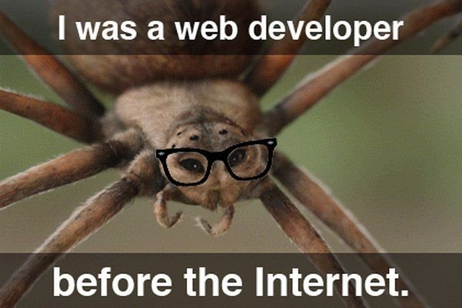
Questions?
@BrandonSatrom
brsatrom@microsoft.com
UserInExperience.com

